Slide 1
How to Download Microsoft SQL Server 2019
Tutorial By Desmond Hughes
5/22/2022

Slide 2
Proposal
Imagine a troubling student trying to download SQL Server. Downloading new software can be hard for most students, that have no experience with downloading software. The software I am referring to is SQL Server especially, being introduce to software like this is sometimes difficult to understand for students. Some might not even understand that a Chromebook is incompatible with the software, and that they need a Windows laptop, or computer.

Slide 3
What You Need To Have:
If you wish to download Microsoft SQL Server, you will need a Microsoft Windows Computer.
You will also need the operating system windows 8 or higher to perform the tutorial.
It is required that your computer or laptop has 6 GB(gigabytes) of space to download the application.
Internet Connection

Slide 4
Problems You Might Run Into
A problem you might run into is a slow internet connection. With a slow internet connection, it is going to affect the downloading speed. If the connection is poor and the internet is slow it will cause the downloading process to be paused or stopped.
*Having multiple devices connected to the internet that are being used also effect the internet connection and speed.

Slide 5
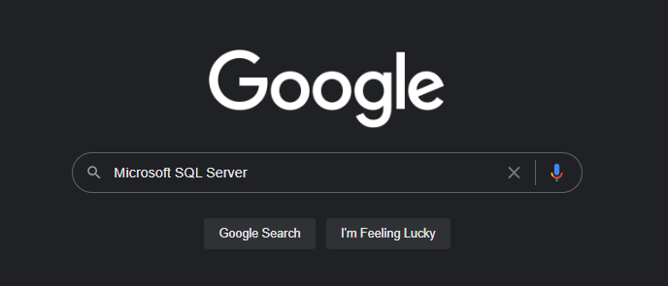
Step 1
Go to Google and type in “Microsoft SQL Server”

Slide 6
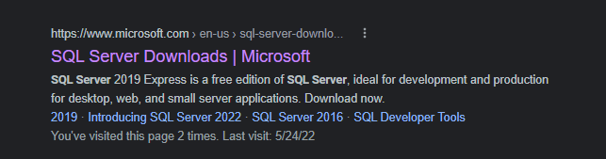
Step2
Find and Click on SQL Server Downloads l Microsoft

Slide 7
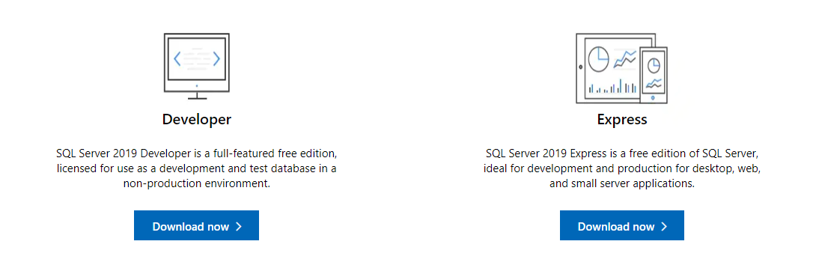
Step3
Then you will pick between Developer or Express version of the application
Developer has all the features, but you can’t use it for production
Express just has less features

Slide 8
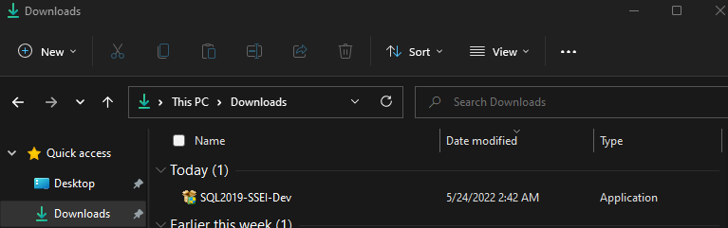
Step 4
After you download the one of your choosing go to you download folder and double click the downloaded file.

Slide 9
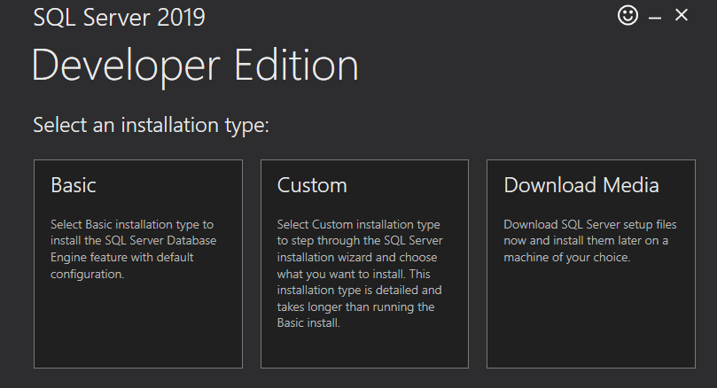
Step 5
Wait for it to load to this page:

Slide 10
Step 6
Then pick between the types
Basic is recommended

Slide 11
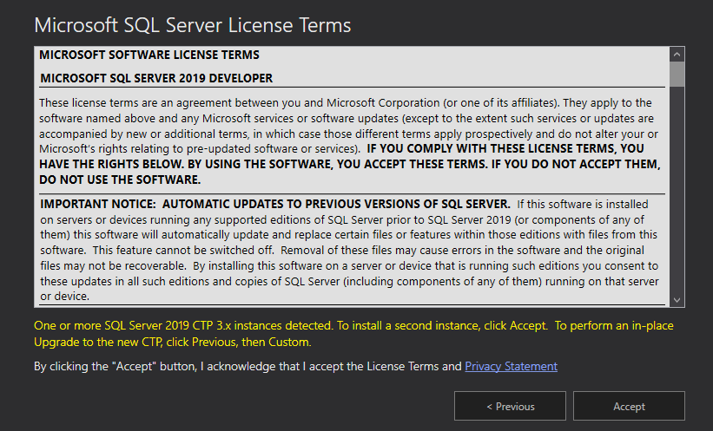
Step 7
Then read the agreement and after you read it click Accept

Slide 12
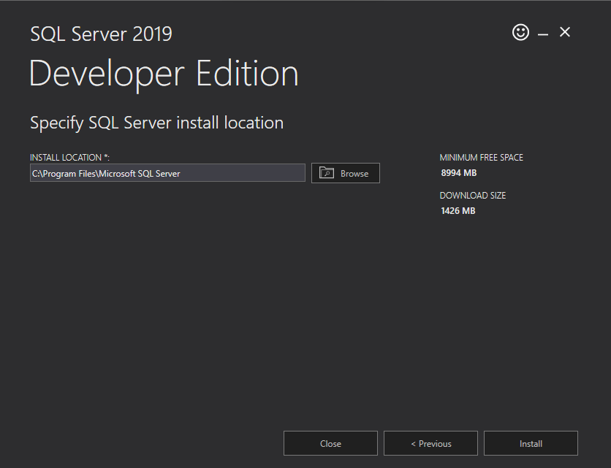
Step 8
Then select the location where you would want the file to be stored and click Install. It may take a few minutes
The recommended location is a great suggestion
Then click install

Slide 13
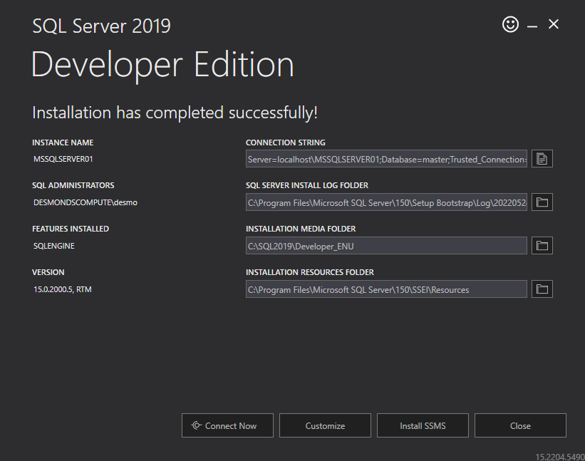
Step 9
After the installing is complete you, screen will look like this:
Then click “Install SSMS”
This tool will help you manage your data in your software.

Slide 14
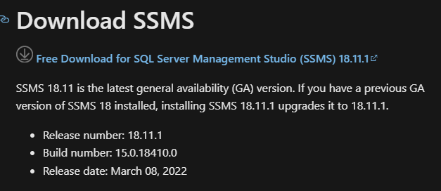
Step 10
It will send you to a website: Download SQL Server Management Studio (SSMS) - SQL Server Management Studio (SSMS) | Microsoft Docs
You will need to scroll down until you see:
Then Click on “Free Download for SQL Server Management Studio (SSMS) 18.11.1”

Slide 15
Step 11
When the file is done downloading open it and allow it to make changes to your device by clicking yes

Slide 16
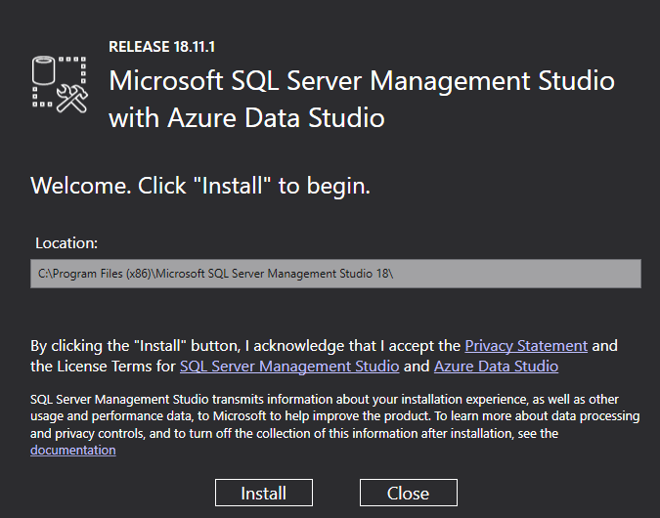
Step 12
You will see a screen like this:
Then click install

Slide 17
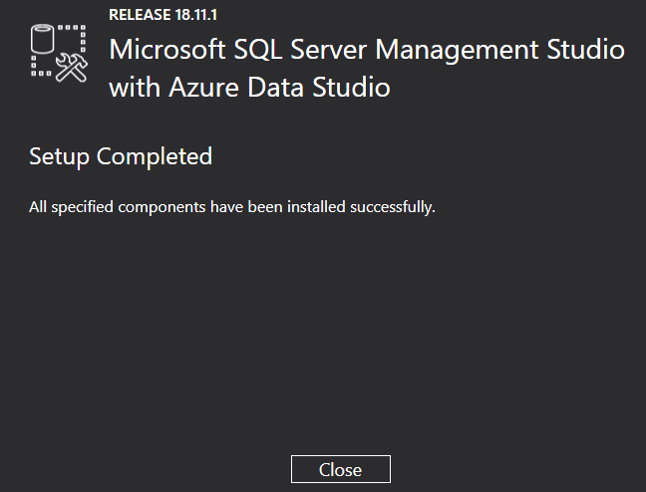
Step 13
After it is finish you will get:

Slide 18
Finial Result:
You now have Microsoft SQL Server 2019 downloaded on your computer!

Slide 19
Conclusion
This tutorial is a good suggestion for students and employees that need SQL Server 2019, whether if it is for school or work. The tutorial is created so that confused individual can figure out how to download the software, without going through any problems.

Slide 20
Reference:
How to Download and Install Microsoft SQL Server 2019 Database and SQL Server Management Studio. (2020). Retrieved 24 May 2022, from https://www.youtube.com/watch?v=SOsZvmTsnbw
Screenshots by Desmond Hughes

